Slide 1
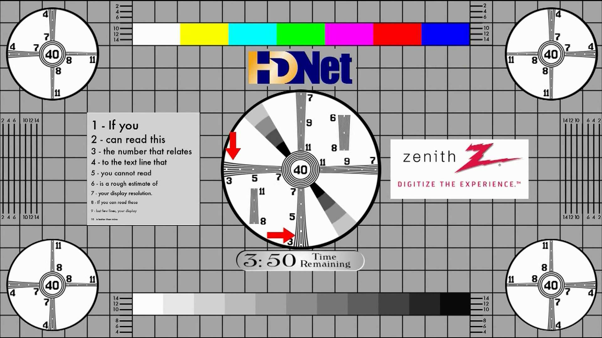
This presentation is made for widescreen (16:9).
If your projector is set up properly, the slide should fill the left and right edge of display area. Else adjust the Aspect Ratio of the projector.
Circles should be round in the test pattern.
You should be able to read the 5th line of text.

Slide 2
How to Read an Academic Article

Slide 3

Genres (ޖޮންރާސް)
Category of writing defined by a certain style
Romance, fiction, education, science fiction are different genres of writing.
Each genre has a different style of writing.
Academic articles are a special genre of writing. The writing style is different.

Slide 4

Genres within genres
Within each genre, there are sub-genres and the style is again different.
For example, education policy articles are written in a different style than articles on cognitive psychology.
Within each, the words and sentence structures are used slightly differently.

Slide 5

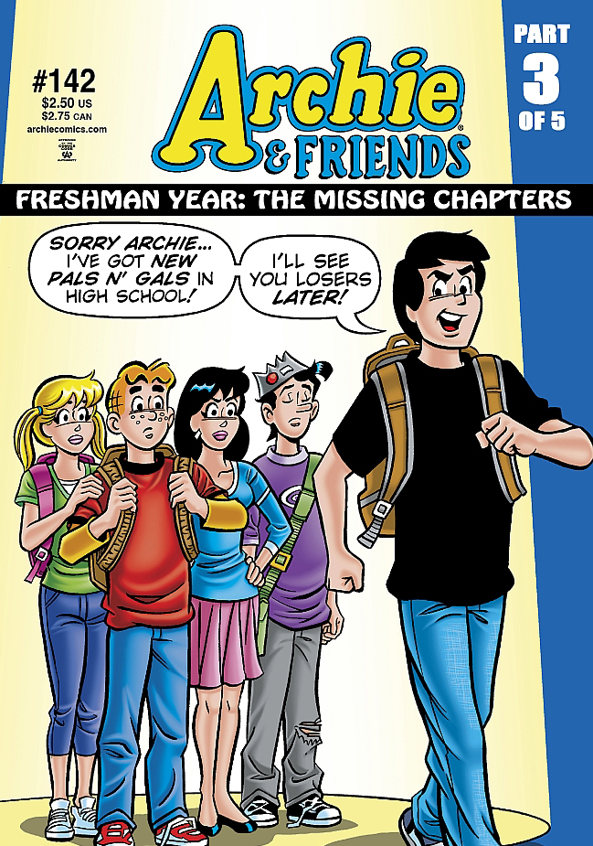
What it means…
Academic articles cannot be read and understood in the same way as a short story, a novel or a newspaper report.

Slide 6

Constructivism and understanding
Notes:
What is constructivism?
Students construct their own meaning from what they see. It also implies that the amount they retain is dependent on the about of construction they do within their minds.

Slide 7

How the mind works
What you learn depends on the effort you make
What you remember depends on the effort you make
The more connections you make with what you already know, the easier to remember and recall… you learn.

Slide 8

No effort = no recall, no understanding

Slide 9
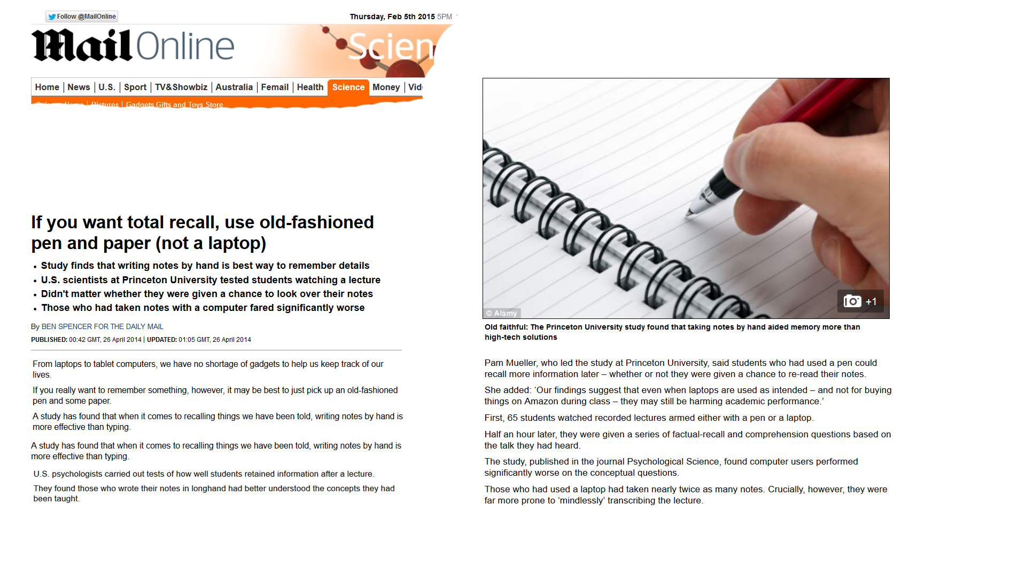

Slide 10
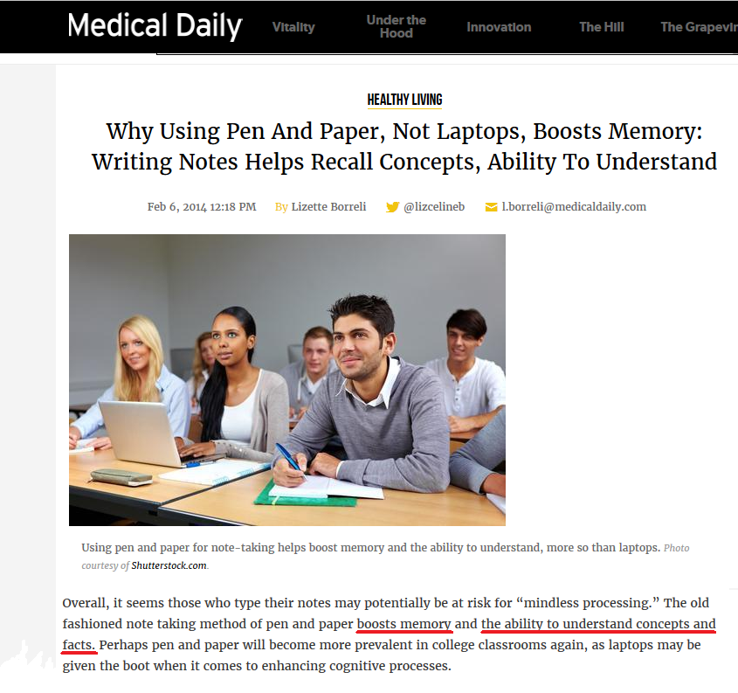

Slide 11
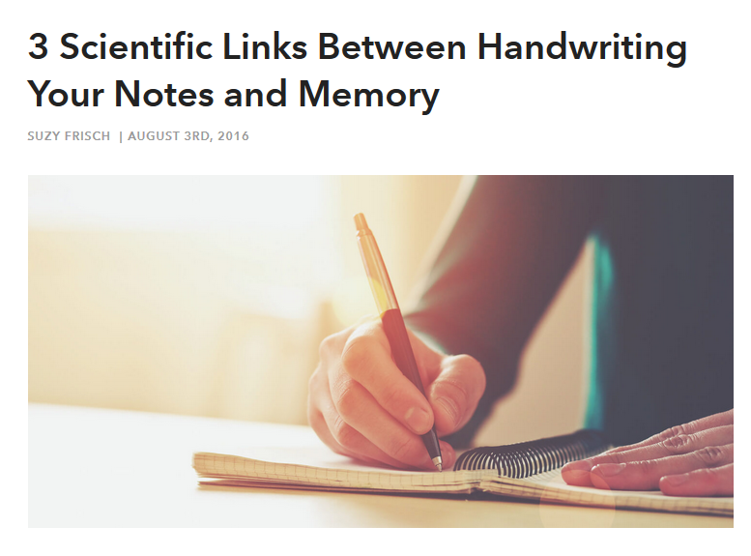

Many research studies…. Same finding
does note-taking help in understanding and recall?

Slide 12
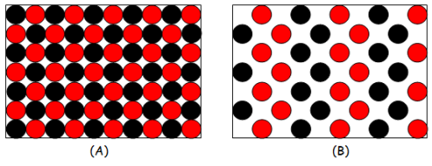
Academic articles are information dense. To understand you may have to read them more than once.

Slide 13

To fully understand an academic article, you may have to parse it several times
Parse: to examine in a minute way : analyze critically

Slide 14
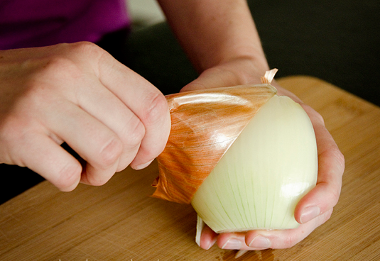
An article has layers of meaning. First reading may not lead to the full understanding of the article.

Slide 15
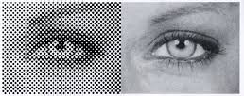
Read from paper whenever possible. Screen has a resolution of about 72 dots per inch. Print has over 300 dots per inch.
Less strain on the eyes. More time to concentrate on reading.

Slide 16

There are several methods of reading academic articles.
What follows is what works for me.
What is best for you may be different.

Slide 17

Step 1. Read and highlight the main sentence(s) of each significant paragraph
Saves more time than taking notes
Your train of thought is not lost

Slide 18
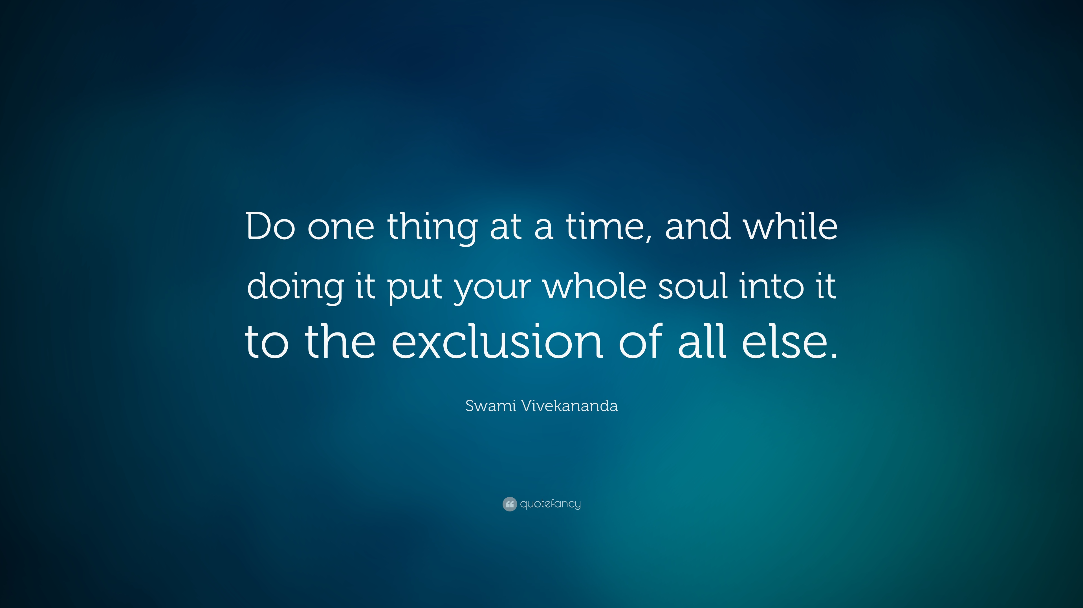
Focus on one paragraph at a time

Slide 19

If you cannot “get” the main sentence in the first time, read the paragraph again. Until you do.

Slide 20

But always focus on one paragraph at a time

Slide 21
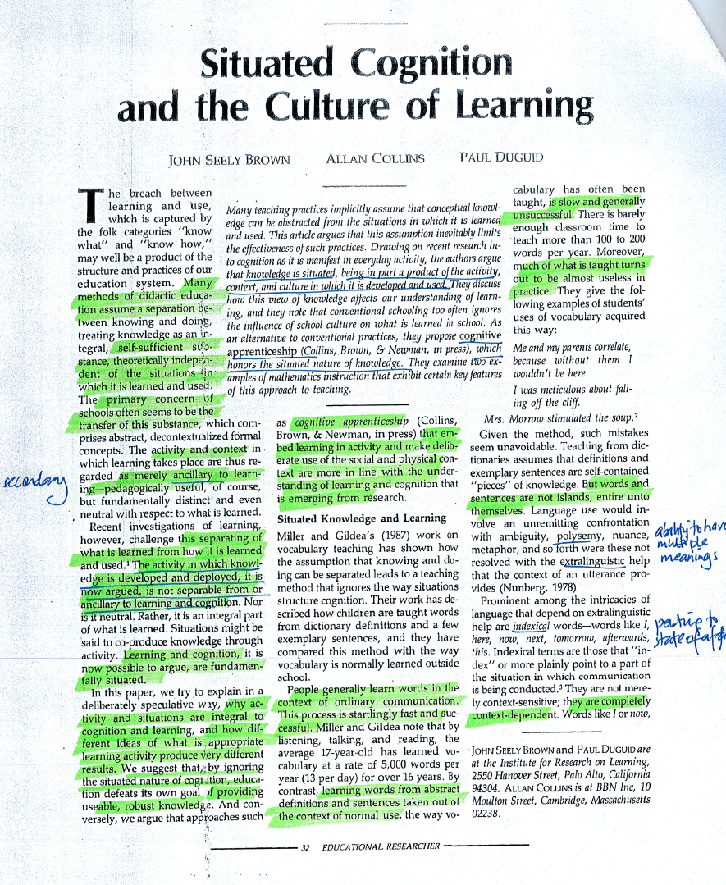
From my doctorate days… an actual sample.

Slide 22

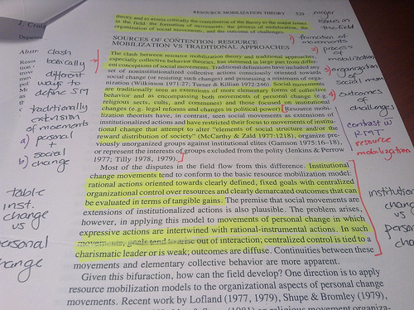
People have different learning styles.
I have also used underlining as well as notes beside the paragraphs.

Slide 23
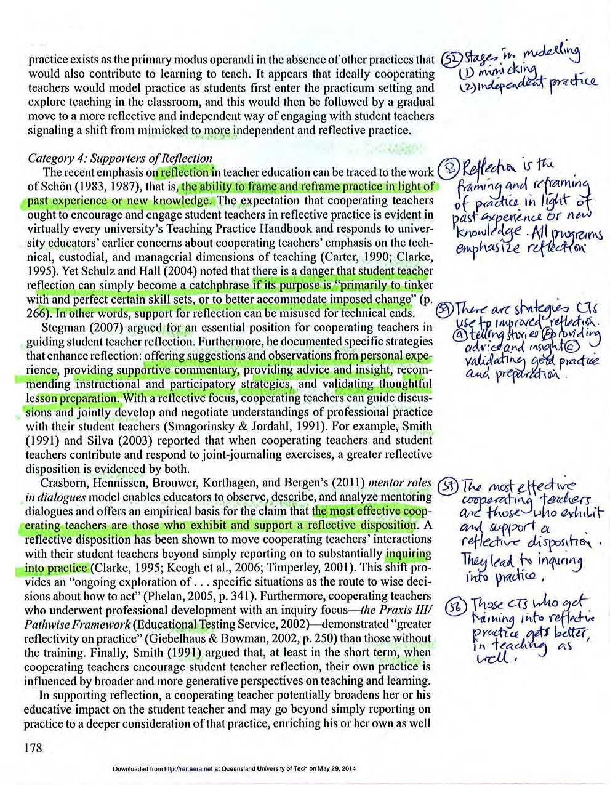
Once you have read or while reading, you should write the gist of the paragraphs in your own words.

Slide 24

YOU
ARTICLE
Your engagement with the text of the article is essential for understanding and recall.

Slide 25

Engagement involves processing the text in some way
For example:
Underlining, highlighting, rewriting, rephrasing or doing some other thing with the text which requires thinking.

Slide 26
Step 2: Making notes
Even if you have textbooks or readings given, making notes is what helps you understand and recall.
Notes are written legibly.
In future, reading notes will be sufficient for complete recall.

Slide 27
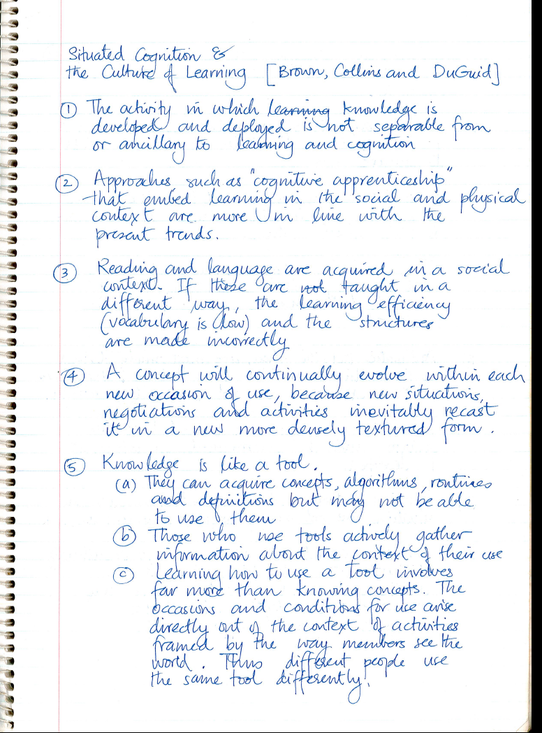
Actual highlighting and notes of the same article

Slide 28
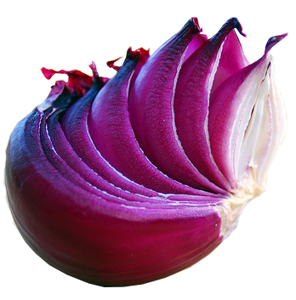
Delving into deeper layers
Look for the main claim/argument/thesis of the article. Ask what it is, why it is important, where it occurs, etc.
Look for evidence for support, and evaluate evidence. Look for counter arguments; evaluate counter arguments.
Evaluate quality of article: strengths, weaknesses, how to improve and re-organise the article.

Slide 29
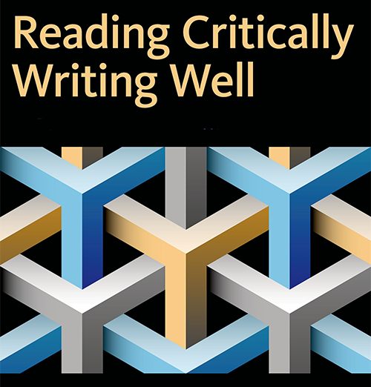
Any word you do not understand must be noted and its meaning found.
—Increases your vocabulary
Any creative and refreshing sentence structures must be noted so that you can emulate the style.
—Enhances your style
Any innovative organisation or structure of the article must be noted.
—Improves your language mastery

Slide 30

Many articles are written after years of work by many researchers. Expecting to digest and understand everything in such an article in three hours is not possible.
Reviews and meta-analyses are about 50 pages long. Such an article cannot be understood in a single sitting.

Slide 31

Not all articles need to be read critically.
Read the title, abstract and conclusion to see whether the article is relevant to your study.
Seminal papers of your sub-field must be read critically depending on whether you are doing a dissertation, a masters or a doctorate degree.

Slide 32

In Oxford, students say that they are reading for a degree; not studying for a degree.
Why do they say so?

Slide 33

Final Advice
Practice, NOT TALENT, is what makes champions.
The more you read academic articles the better you would become.

Slide 34

If you find this presentation useful, you may find other presentations and articles by H Hameed helpful, too.
Visit: http://www.hassanhameed.com/?page_id=149

