Slide 1
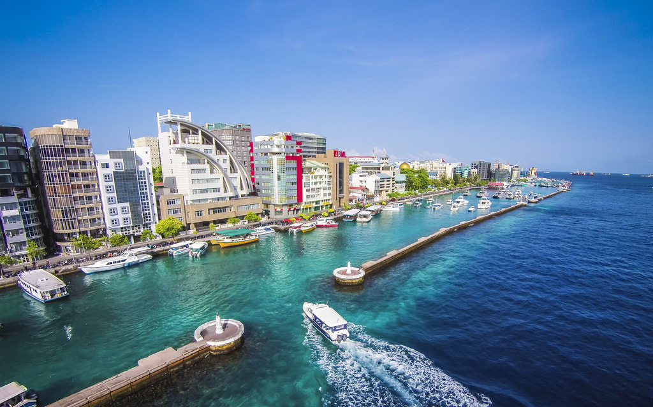
PRC Information Session
Thesis Examination
2015 Events

Slide 2
Meetings on 1st Sunday Afternoon of Every Month
February: Preparation of Initial Research Proposals
March: Academic Writing
April: Thesis and Publications
May: How to Prepare the Final Research Proposal
June: Ethics, Plagiarism and Data Collection
July: Using Microsoft Word for Thesis Writing
August: APA Referencing Style
September: Managing References
October: More on Academic Writing
November: Thesis Examination

Slide 3
PRC Information Session
Thesis Examination
Nomination of examiners
Conflict of interest
Thesis Submission
Formatting your thesis – front page requirements
Examination
Classification
Revisions
Submission of final version of theses

Slide 4
Thesis Examination Authority
First point of contact Dean of relevant faculty
Deputy Vice Chancellor for Academic Affairs
Higher Degrees Committee

Slide 5
Nomination of Examiners
• Supervisors, generally Principal Supervisor, will discuss potential examiners with other supervisors and the student. The Principal Supervisor or nominee shall write to the potential examiners together with an extended abstract to seek their agreement.
• Supervisors should complete nomination form at least 3 weeks prior to the intended submission date.
> include copy of thesis abstract
> 5 examiners for PhD (Three will be selected. Two as reserves) [no examiner from MNU. At least 2 from overseas who has demonstrated expertise in the area.]
> 2 examiners for Masters (and reserve) – at least 1 external.
> There is a special form for nominating examiners.
• Final approval of examiners by HDC or nominee.

Slide 6
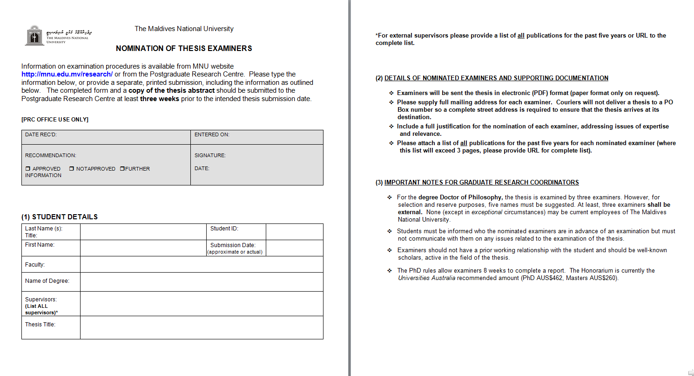

Slide 7
Forms… Forms… Forms
• Many forms used in examination processing are on the website.
• There are forms for submission of thesis for examination, certificate of agreement of supervisors for examination (which have been incorporated in the thesis proper), forms for final submission, etc.
Students are well-advised to go through all the form available online.

Slide 8
Selecting independent examiners
In most universities, independent examiners who are competent in the field of research is selected. In UWA, none of the examiners can be the University. In MNU, all can be external to the university but a least two must be external. Local examiners can introduce bias to the examination process.
It is difficult to find competent active researchers in narrow fields to be examiners.

Slide 9
Managing Conflict of interest
Conflict of interest can introduce bias to the examination process.
Excluding conflicts of interest protects the students, supervisors and the examiners from negative perceptions.
Potential or actual conflicts of interest must be declared.

Slide 10
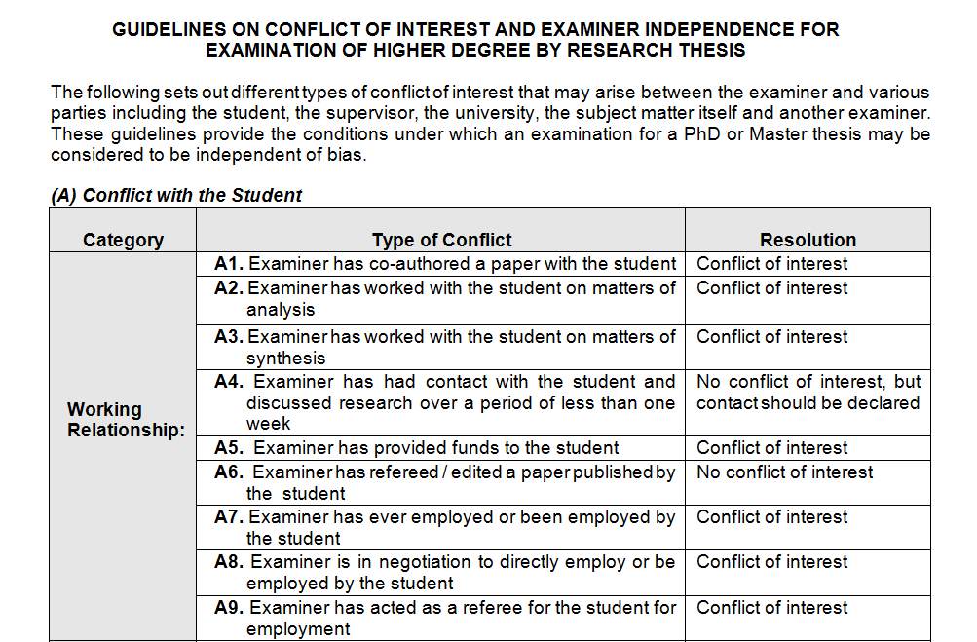

Slide 11
Thesis format
Thesis templates are available for download but these are not substitutes for knowing APA Publication Style.
Invest in a paper copy of the APA Publication Manual.

Slide 12
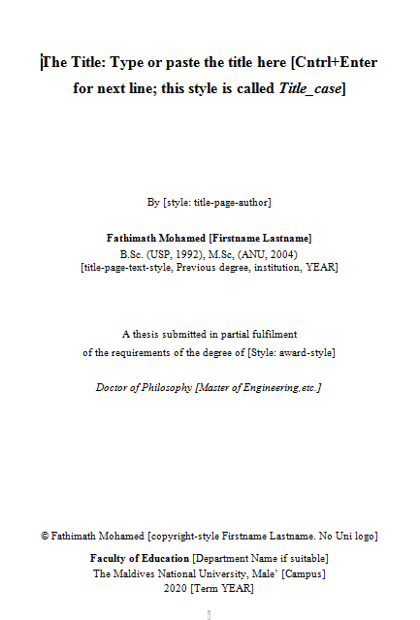

Slide 13
Thesis submission
With the “Thesis Submission Form Thesis”, the thesis must be submitted for examination as a pdf copy.
The thesis is to be submitted to the Secretary of the Higher Degrees Committee (See PhD rules: 5.1).
Upon submission, the enrolment status will change and any scholarship will cease.
Thesis is sent for examination. Student informed of status.

Slide 14
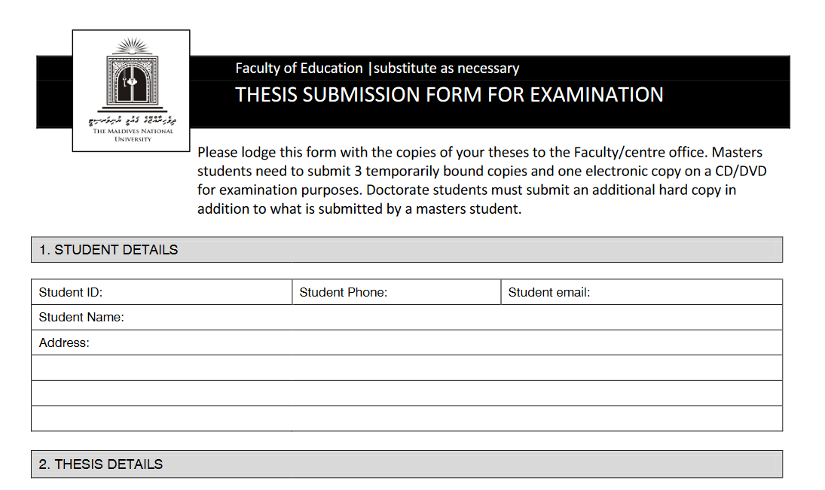

Slide 15
Thesis submission
Thesis Examination
• Requested examination time is 6 weeks
• Average time of examination is 4‐5 months
• Examiners will provide
Written report (1‐2 pages)
Scores for 6 criteria
Recommendation for classification
• Board of the Graduate Research School will consider all examiner reports and classify your thesis
• Official email notifying you of examination outcome
• includes graduation information

Slide 16
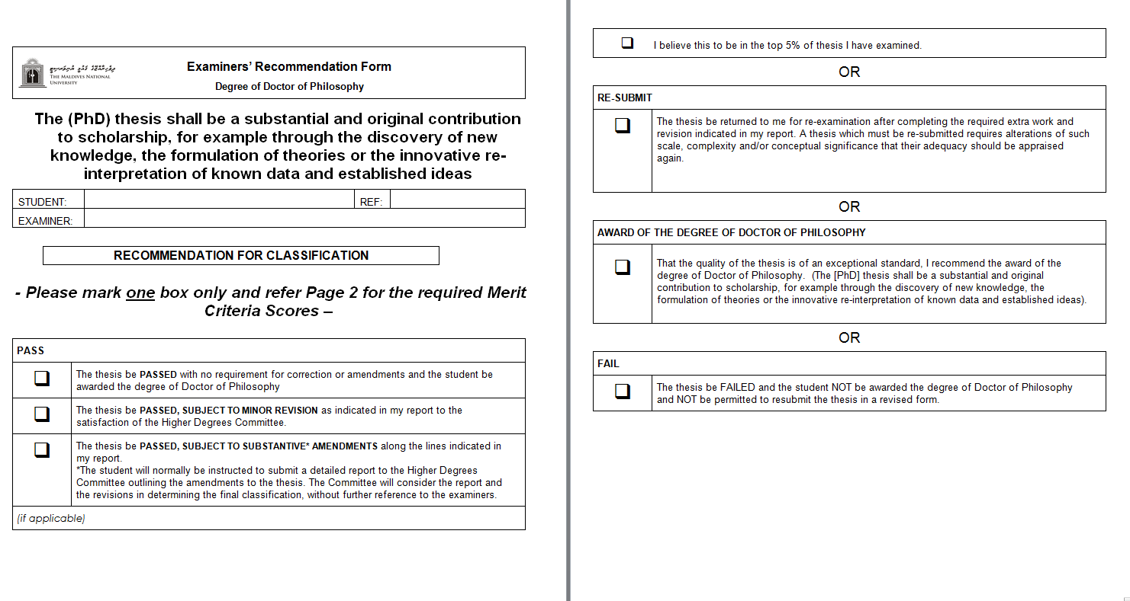

Slide 17
Oral Examination
Oral examination is a requirement. Duration is 1 to 3 hours. Usually one or two examiners are present who asks the questions on behalf of others. The venue is a small meeting room or classroom. The student is informed of venue and time, eight days in advance by the Faculty.
Chairperson and student must agree to all arrangements including audio recording. Chairperson is an independent academic staff from MNU. Support persons may be present but they may not speak nor would the supervisors except at the end. Students must take a copy of the thesis to the oral.
The chairperson opens the meeting. After the greetings to make student feel at ease so that s/he can perform best, student makes an introductory statement. Questions follow.
At the final stage, the candidate is asked to leave and the examiners will discuss among themselves and make the final recommendation. Individual examiner recommendations are actually on the Examiner Report Form. The student is called in to deliver the good or bad news.

Slide 18
Thesis Corrections
Before a student graduates, the student must make all the corrections (if needed) and submit the final thesis.
The time for resubmission varies depending on the extent and nature of corrections. Minor corrections may be carried out within a week, but substantive major corrections, and re-examinations may vary from three months to nine months. See 5.4 ii to iii.

Slide 19
Submission of Final Thesis
Submit two hard copies (bound in black buckram) to the Faculty Office.
Submit the soft copy in pdf format for upload to the theses repositories.
Details in the “Submission of the Final Version of Thesis Form.”

Slide 20
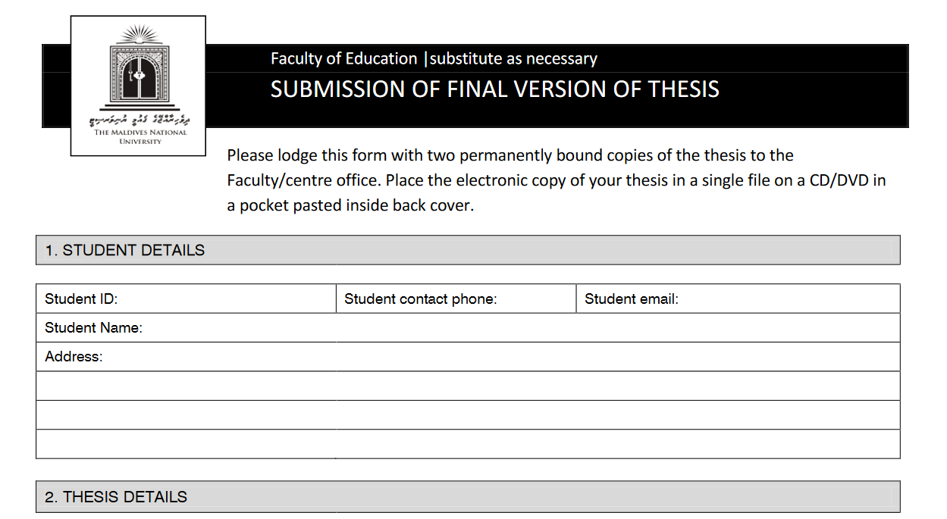

Slide 21
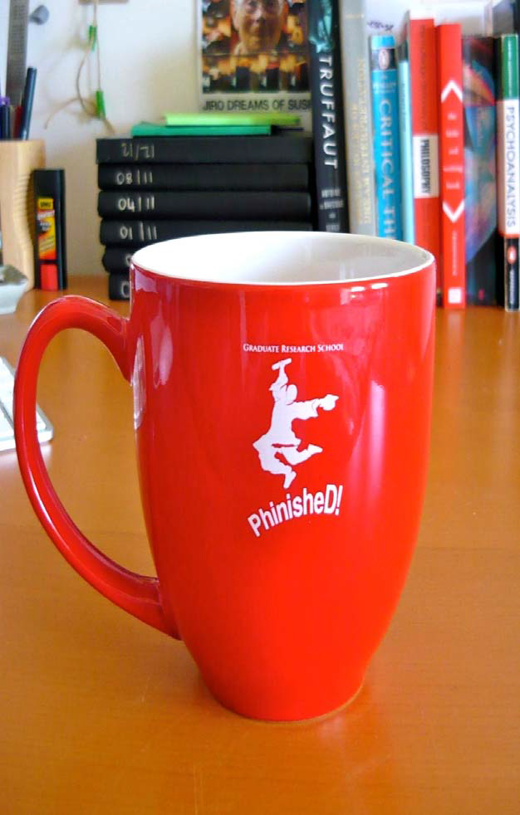
END
UWA image

