Slide 1
Supervising Research Students
H Hameed, VC, MNU
12th March 2013

Slide 2
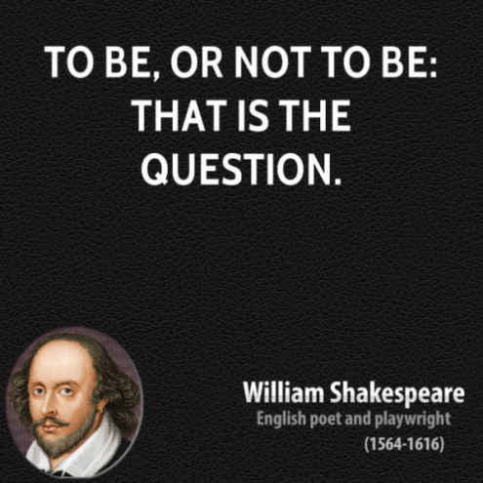
Major decision not to be taken lightly
Often 1 to 4 year commitment
Serious impacts for your reputation depending on how you perform.

Slide 3
This is an extremely important matter:
research has shown that failure or success of a PhD project is largely determined by supervision (Berger & de Jonge, 2005)

Slide 4

Ineffective supervision will diminish your standing among colleagues and your chances of promotion.
Impacts negatively on the student due to loss of time and effort for the student and diminished reputation of the university.
Satisfying for professional development in terms of joint publications, increased knowledge and reputation.
Often creates benefits that extend beyond foreseeable future and career.
Number of successful completions have an impact on promotions.

Slide 5


Involves much reading and time. The general rule is to leave 15 (Sydney) – 45 (Edinburgh) hours per student per year.
Need outstanding expertise in language, research methods, content area and publication style.
Requires much commitment and technical expertise to guide, scaffold and demonstrate,
An attitude of support and assistance is required to train a student to be an independent researcher.

Slide 6
Workload allocation
An academic staff works normally 1560–1595 hours per year.
Normally about 660 hours are allocated for research. May vary across universities. For research focused staff this allocation may be increased (between 957-1276 hours).
A research supervisor will not normally supervise more than 5 full-time equivalent postgraduate research students at one time, or pro rata for a supervisor employed on a fractional basis.
Universities allocate about 78 – 120 hours per student to be distributed among all supervisors of that student depending on their involvement and role.

Slide 7
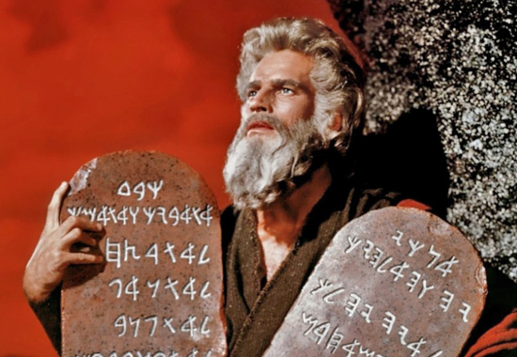
Enthusiasm for the project and the student.
Sharing supervisor's knowledge, experience and with the student.
Regular and when necessary emergency meetings.
4. Prompt review of manuscripts, abstracts and other texts.
5. Guarantee availability of funds, facilities and support.
6. Supervisor and student should keep track of the progress of the research project.
7. Recommend courses, texts, conferences for the student.
8. Maintain a balance between guidance and independence.
9. Provide feedback about work and progress of the PhD student.
10. An open culture in which students are not hesitant to ask questions if required.
Supervision must be personalized.
12. Supervision should aim at letting the student develop into an independent scientist/researcher.
Commandments for Supervisor

Slide 8
Styles of supervising
Style varies with supervisors and with students. Often the type of the student dictates the nature of supervisory style.
Styles include:
Master-apprentice approach
Facilitator, professional partner approach
Laissez-faire approach
Not an exhaustive list as there are as many approaches as there are supervisors and students. Often depends on the competencies and commitment of supervisor and student.

Slide 9
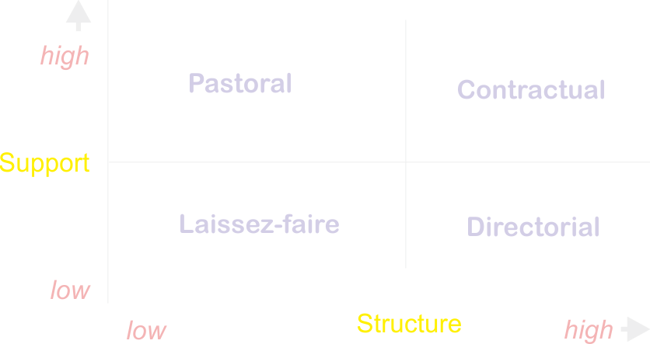
Garfield’s paradigm of supervisory styles
Source: A Handbook for Doctoral Supervisors
Notes:
Laissez-faire
Assumes student capable of managing both project and themselves. Leaves problems to take its course.
Pastoral
Assumes student capable of managing project but needs personal support/encouragement.
Directorial
Assumes student not capable of managing research project but can manage themselves.
Contractual
Assumes student needs high levels of academic and pastoral support.

Slide 10
Styles
Quality Controller 3, 9, 10
Friend 1c, 12
Coach 4, 5, 7, 11
Co-writer 8, 11
Delegator 1
Expert Guide 2, 5
Key:
1 Initiation
2 Research design
3 Research proposal
4 Fieldwork
5 Data analysis
6 Write up
7 Final fieldwork
8 Editing
9 Acceptance
10 Defence
11 Follow-up
12 Separation
Styles of supervision during the various stages of the research process.
Ahmed A. Wadee, Moyra Keane, Ton Dietz & Driekie Hay
Notes:
Ahmed A. Wadee, Moyra Keane, Ton Dietz & Driekie Hay

Slide 11
Attributes of successful supervisors
• approachable and friendly;
• supportive, positive attitude;
• open minded, prepared to acknowledge error;
• organised and thorough; and
• stimulating and conveys enthusiasm for research.

Slide 12
Types of research students
Independent Student
Doesn’t like a circus of supervisors
Meets occasionally; three or four times during the candidature
Student preferring a relationship
Some PhD candidates do not mind a personal relationship with their supervisor, as long as there is not much (or even no) discussion about the progress of the PhD work or its products.
They seek support indirectly.
Business like student
Cannot function without a personal touch and interest in their life and personality as a whole.
Personal interest, interactive student
Product/task-oriented personalities like defined roles, clear goals, planned timing, agreed communication patterns and behaviour, and reliability on both sides.
No personal talk
Personal-relationship, process-task personalities are personality-oriented, empathic, liking social-emotional bonds, with trustful and fluid arrangements.
They prefer meetings which start with small talk and they like to share experiences beyond the PhD work.
Two things impinge the student:
Supervisor : student chemistry and faculty/centre culture
Notes:
5.2.1 The independent student
Supervisory styles have to do with the personality and position of the supervisor(s), but they also have to do with the personality and position of the PhD candidate. Some candidates have a very independent attitude, and they want to do the job alone. They would prefer a ‘delegator’, without a ‘circus of supervision’ around them, and they want to keep the supervisor at a distance. In extreme cases, they will meet once in the beginning and, the next time, a few years along the line, the candidate presents a full product and graduates on the basis of that product without a single word exchanged in between. These types of candidates do not like being told to go to courses; if they need some, they will organise it all themselves.
5.2.2 Students preferring a personal relationship
Some PhD candidates do not mind a personal relationship with their supervisor, as long as there is not much (or even no) discussion about the progress of the PhD work or its products. ‘You will see it when I am ready.’ If there are problems (e.g., about funds for doing the research or about facilities), they will spread word of it in the circle around the supervisor, and expect their friend to become aware of it and work on a solution.
5.2.3 The businesslike student
There are many PhD candidates who would like to keep the relationship businesslike and who do not like any interference in their personal lives. Businesslike, product/task-oriented personalities like defined roles, clear goals, planned timing, agreed communication patterns and behaviour, and reliability on both sides. They find it irrelevant and sometimes even a bit confrontational for supervisors to know about their home situation. But they like being guided to become a good scientist and prefer a cool, efficient style for meetings that give them useful suggestions about what to do next and how to improve. In some cases, they do not mind, or even like, knowing continuously if they are on the right track, and they prefer supervisors who continuously create an experience of examination in all their meetings. They always try to perform at their best during these meetings and like being judged on the quality of their performance.
5.2.4 The personal-interest, interactive student
On the other hand, there are PhD candidates who abhor those practices and who cannot function without a personal touch and interest in their life and personality as a whole. Personal-relationship, process-task personalities are personality-oriented, empathic, liking social-emotional bonds, with trustful and fluid arrangements. They prefer meetings which start with small talk and they like to share experiences beyond the PhD work. Some prefer getting continuous advice on their performance, with attention to their personality; others prefer focusing on their written work, but they expect a lot of detailed, to-the-point suggestions for improvements. On really difficult parts of the analysis or of the writing process, they would like their supervisors to take co-responsibility, either for doing the job together or for hiring expertise for expert assistance.

Slide 13

Full-time vs part-time
Experience over the years has taught me that part-time students get less from a research degree than a full time student.
If students are serious about research training they should enrol full-time.

Slide 14
Student motivations to do a PhD
You are interested in and curious about the topic.
You want to train to become a researcher.
You want to train others to become researchers.
Research appeals you.
You like the title Dr before your name so friends and others will give you the respect you deserve.
You want to advance in your career.
You can get fame, wealth and power.

Slide 15
Essential Reading
Rules of the degree and specifications for thesis.
Relevant policies (such as ethics, plagiarism, IPR, etc.) and administrative forms (for supervision, ethics, progress, etc.).
Close familiarity with both quantitative and qualitative paradigms, inferential statistics (if quantitative), validity issues, ethics, etc. Auditing a research methods course is very useful.
Academic writing and style need to be internalized through copywriting or repeat reading of manuals. This is a major weakness of students who had even completed doctorates overseas.
Students need to own essential textbooks and relevant documents in paper.

Slide 16

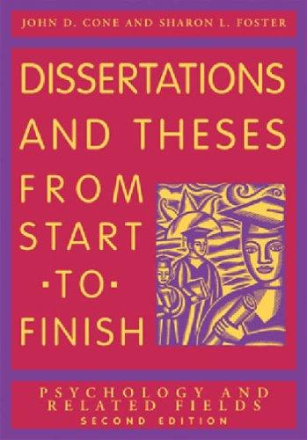

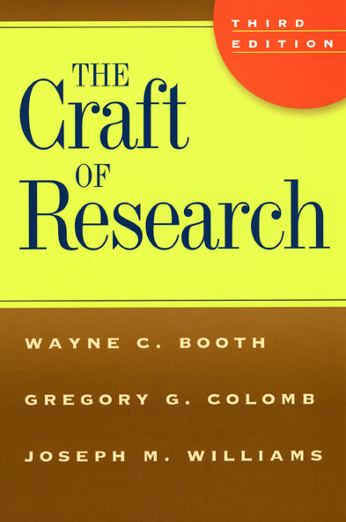
Students must own essential texts of the discipline

Slide 17
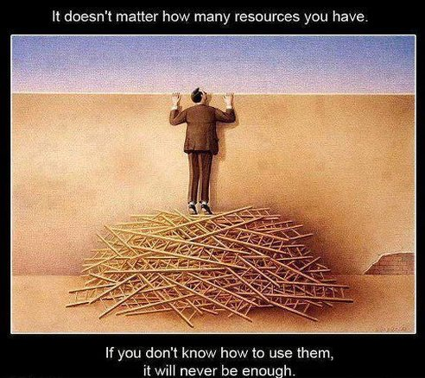
Becoming familiar with available support

Slide 18
First steps
Become familiar with the extent and nature of support available from the university: Library, Student Support and PRC.
Student must attend induction programs and engage in training modules.
Get to know other supervisor/s.
Organize meeting times with the student and establish communication protocols.
Get information on scholarships available.
Find out when & who to contact if problems arise.

Slide 19
Changing supervisors
The procedure for switching supervisors must have been established by your faculty. Usually, this is a form-based request.
If there are genuine issues, students must be told to keep paper-based record of grievances.
Students must be advised to talk to the co-supervisor or another member of the staff. Common reasons for changing supervisors:
  lack of time and competencies to support the student adequately
  Student not receiving adequate feedback
  Generally absent
  Overbearing

Slide 20
Initial proposal

Slide 21
How to select problems
Initial proposals to get admission to course is invariably inadequate.
Generally, problems that lead to theories are better than ad-hoc problems. Initial proposals suffer from being:
  Unsuitable in scope (too wide/narrow)
  Un-researchable
  Not clearly defined (ambiguous)
Often a student is required to spend almost a semester defining or clarifying a researchable new relevant problem and write a proposal.
During this time weekly meetings with supervisor is essential.

Slide 22
Features of a suitable topic
It should be of sufficient interest to the student. The interest has to be sustained for the period of candidature, almost four years.
The student and supervisors must have the competence to research the topic.
The student and the university must have sufficient resources for the research (equipment, skills, access, etc.).
It must be of sufficient scope for a masters/PhD.
It must be of significance in terms of contribution to theory, knowledge and practice.

Slide 23

Thesis examiners
Selecting:
For masters students, two examiners are selected. For PhD, three examiners are selected. Potential examiners are discussed with the student about three months before submission.
For doctoral theses 2 examiners must be external to the university.
Examiners must not have provided support to the student during candidature.

Slide 24
Thesis examiners
Guidelines are provided for examiners
UNE – re conclusions and implications developed appropriately and linked clearly with the nature and content of the research framework and findings?
Is the literary quality and general presentation of the thesis of a suitably high standard?
Does the thesis as a whole constitute a substantive original contribution to knowledge in the subject area with which it deals?
University of Melbourne – ‘It is a careful, rigorous & sustained piece of work demonstrating that a research “apprenticeship” is complete & the holder should be admitted to the community of scholars in the discipline’

Slide 25


Slide 26
Publishing
Publishing is important if you wish for a career in academia.
Reach out to fellow researchers and experts in the area through email. They, more often reply and respond kindly than not.
Plan for publication while still a student. Depending on supervisor input to the paper, joint publications are possible.
Present at workshops, seminars, conferences, etc. to develop your confidence and to network.
Do not submit the same article to two journals at the same time.
- 26

Slide 27
Reasons for publishing
Every academic staff is required to spend a sizeable amount of their work hours in research. Varies from 20% to 60%.
An objective of research is to expand knowledge; therefore, dissemination is critical (unless research is military or has potential for business generation).
Academic staff becomes well known and recognized among the community of researchers.
Career advancement is tied to measured publication output.
Some reviewers go through your drafts very carefully so that you can see your mistakes; the process is educative.

Slide 28
Where to publish
It is difficult to get published in high impact journals unless the paper is intended for a worldwide audience. Acceptance rate is about 5% to 10% for some journals.
Most overseas journals require a payment for publication which may vary between $45 to $3500.
For localized research, MNJR is fine. The number of issues per year of MNJR will be increased to meet requests.
Journals are usually refereed, it may be print, print and online and online only.
Open access and access by subscription are other modes.

Slide 29


Journals
Refereed Journals
Non-refereed Journals
Articles are “refereed” by recognized experts of the discipline. Author is not known to referees nor referees known to author (double blind refereeing)
Articles are not refereed by subject matter experts.
Publishing decision made by the editor (s).

Slide 30

MNJR
Double blind refereeing.
Intended to be split into arts and sciences once quarterly issues are unable to meet publication requests.
Intended as a medium for staff and student publications.
Five free copies for the author of a published article. No fees.

Slide 31
Why articles get rejected
Wrong type of journal
Article is not an “an article” (may be thesis chapter, etc.)
Too long/short
Journal conventions not followed
Style (Journal English is a different genre of English)
Insignificant findings
Aimed for a local audience
Methodology/framework errors conflict/does not substantiate findings
Unethical and rude
Sloppy English

Slide 32
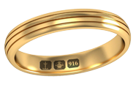
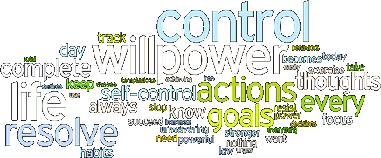
The hallmark of a good research student is discipline.
Mind over matter.

