Slide 1
Policy Processes in the Evolution of Education in the Maldives:
1900–2015
Notes:
Asaalaam Alaikum
First of all, I would like to thank all of you for taking time to attend my proposal confirmation meeting.
I would talk for about 20 minutes and open the floor for questions.
Let me first begin by telling you why I have selected this particular topic for my PhD studies.
Well, while I was reading for my Masters Degree in UWA, Western Australia, one of the core units I had to do was Education Policy Trends: Global to Local.
The unit was taught by my external supervisor Professor Vidovhich.
The study of the ideas and forces that shape what we do and learn at institutions and their implications for citizens and their nations really interested me.
After returning home from studies, in 2013, I taught the same module with some changes at the Maldives National University.
I decided to undertake a formal study of the Maldives education policyscape to satisfy personal interest and curiosity in the subject area.
The title of my study is: Policy Processes in the Evolution of Education in the Maldives: 1900–2015.

Slide 2
Outline
1
2
3
4
5
Literature
Review
Research
Design
Research
Methods
Candidature
Plan
Introduction
Notes:
My presentation is organized to 5 main parts.
First I will be introducing my study to you,
Second I will talk about the literature review followed by the Research Design and the Research Methods.
I will end this presentation with my candidiature plan

Slide 3
Aim
To analyse key education policy reforms in the Maldives over the time period 1900-2015 using an extended ‘policy trajectory’ framework which includes policy influences, policy text production and policy practices/effects
Notes:
Since the beginning of the 20th century, there has been a wide range of education policies implemented in the Maldives, each with the explicit aim of reforming the previous one for its shortcomings or addressing prevailing educational imperatives.
Some of these policies resulted in unintended outcomes necessitating review or change of the whole policy.
Yet, there has not been a comprehensive analysis of these policies for their successes, unintended outcomes and actual consequences.
In this study I plan to analyse the important educational reforms that have been introduced in the Maldives since 1900. To analyse key education policy reforms in the Maldives over the time period 1900-2015, using an extended ‘policy trajectory’ framework which includes policy influences, policy text production and policy practices/effects.

Slide 4
  Motivation and Rationale
Global
the combination of historical and contemporary education policy analysis will make an original contribution to policy studies for similar nations
Maldivian experiences can corroborate findings elsewhere.
National
No systematic analysis of the post-1900 Maldivian education policyscape
Many past policy actors at an advanced age
The distinctive educational values, systems and histories of Maldives will be better understood
Past can act as an evidence base for future
Personal
Enthusiasm towards policy studies during Master level studies and teaching
Notes:
My motivation for this study come from 3 different level.
At a Personal Level:
As I have told you at the beginning, I have developed a special interest for this area during my masters studies and while teaching.
National Level:
In no extant document I accessed or heard of, has there been a systematic analysis of the post–1900 Maldivian education policyscape.
Many of the policy actors in the past century are at an advanced age and opportunities for data gathering available now, may expire soon.
it is believed that if a particular idea or approach has been tried before, even in different contexts and circumstances, past results can act as an empirical evidence base for on-going policy refinement and development.
Global Level:
the study is important at a global level because of its implications

Slide 5
Literature Review
What is policy?
Policy as Text
Types of policies
Material vs symbolic
Education Policy: Changing Ideologies & Globalisation
Old Humanists
Policy Analysis
Policy as process
Policy as discursive
Policy as value-laden actions
Incremental vs Rational
Distributive vs redistributive
Regulatory vs deregulatory
Industrial Trainers
Public Educators
Globalisation and Neo-liberal Ideology
Types
Evolution of policy analysis
Notes:
The literature review is divided into four main sections.
First, there is an overview of definitions of the term ‘policy.’
Second, the various types of policies are discussed.
The third section of the review discusses the various ideologies which have informed and shaped educational policy.
In the final section, policy analysis is described from an evolutionary perspective.
The view of ‘policy as text’ considers policy as written or spoken text dictated by policy makers and expected to be followed by policy subjects.
A policy cannot be treated free from the values of policy actors. Kogan has identified four sets of values: educational values, social values, economic values and institutional values that inform and shape up policy.
Since the 1980s policy has been identified as a process that is often represented as a cyclic. The policy process includes setting up of policy agendas, formulation of policy text, the enactment of policies, practices and effects.
A fourth view conceptualizes policy as mobilising specific discourses within or across its various texts and processes. Discourse focuses on why a particular statement appeared rather than another. Discourse embodies “meaning and social relationships” and constitutes both “subjectivity and power relations.

Slide 6
Research framework
…the lens through which the researcher views the reality of the whole policy trajectory–the different phases of policy making and enactment (Ball, 1994).
It constitutes the assumptions, values, methods and practices that underlie policy analysis.
Notes:
Most research reports cast the problem statement within the context of a conceptual or theoretical framework.⁴
A description of this framework contributes to a research report in at least two ways because it (1) identifies research variables, and (2) clarifies relationships among the variables. Linked to the problem statement, the conceptual framework “sets the stage” for presentation of the specific research question that drives the investigation being reported.
The framework chosen by a researcher assists the researcher to organize his or her thinking about how to approach social phenomena being studied
The conceptual framework to be used in this study is the ‘policy trajectory’ approach which is derived from the critical theory paradigm and Post-structuralism .
Most of u know a trajectory as the path taken by a heavenly body on it’s orbit. In policy terms it is defined as the process through which the policy process takes place. This incorporates the different contexts as well as the levels.
Both critical theory and post-structuralism are concerned with power but they conceive of it in different ways:
Critical theorists – focuses on the big picture, the macro – some groups in society have more power than others e.g. the policy elite in government who set policy agendas. In education, this theory is concerned to see if policies can help the disadvantaged students.
In Poststructuralism – the focus is on the micro or ‘little picture’–
power circulates at the micro level and can play out differently in different contexts. In education, this theory highlights that policies will play out in various ways depending on the place and time.
The key advantage of using both theories in this study is that the policy analysis can span macro to micro levels of the policy trajectory (ie from global policy trends, through national policies, to policy practices within educational institutions).
When applying this approach, the relative emphasis of critical theory and post-structuralism varies at different points. While critical theory is mainly used to identify the broader patterns of power operating at the macro level, the post-structuralists’ view is used to identify the different interpretations and enactments at the micro-level

Slide 7
Ball’s Policy trajectory approach
… the different phases of policy making and enactment (Ball, 1994)
the context of political strategy
the context of outcomes
the context of practices/effect
the context of policy text production
the context of influence
Ball, Rizvi & Lingard (2010) and Vidovich (2007; 2013)
Notes:
Let me give you a brief introduction of the policy trajectory approach
In his seminal work on the policy trajectory, Stephen Ball proposed five contexts
The context of influence is where policy actors contest, negotiate and struggle over the construction of policy.
In the context of policy text production, the text is produced with negotiation among different parties.
In the context of practices/effects, the policy is subjected to multiple translations or recreations by the actual practitioners of policy.
The context of outcomes considers the impact of the policy on existing social inequalities while the context of political strategy devises plans to address these inequalities.
In this study, the primary emphasis will be on the first three policy contexts: context of influence, context of policy text production and context of practices/effects, although the final two contexts will be referred to in the discussion of findings.
In its evolution over time, this framework has offered useful tools for policy analysis.

Slide 8
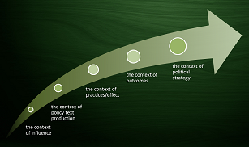
Research questions
How have global and national influences affected education policy development in the Maldives between 1900 and 2015?
What were the features of the key policy texts in the evolution of education policy in the Maldives (1900–2015), and how were the policy texts produced?
What were the practices/effects stemming from each of the major education policy developments in the Maldives (1900–2015)?
What are the long-term outcomes and implications of historical and contemporary education policies in the Maldives for the future, especially with accelerating globalisation?
Notes:
For the purpose of this study all the major policy reforms in the period under study will be analysed, and for each major policy reform, a policy trajectory approach will be applied.
In addition, the implications of the findings for the future will be examined. Specifically the four research questions are

Slide 9
Research Methods
Qualitative Research
Historical Approach
Contemporary Policy Analysis
Notes:
The methodology used in this study falls under qualitative Research.
The study is a policy analysis using a historical component thus historical approach and contemporary policy analysis will be used in this study.
The sources used in historical research can be identified as either primary sources or secondary sources.
A primary source is an original source prepared by a participant or an actual witness of the event studied.
A secondary source is one which is prepared by a person who is not a direct witness or a participant of the event.
Two ideas, the concepts of external criticism and internal criticism, become paramount when evaluating historical sources
External criticism refers to authenticity of the source. When the genuineness of the source is guaranteed then the author is faced with identifying the accuracy of the content in the sources, which is termed as internal criticism

Slide 10

Sampling
Purposive sampling
The researcher chooses the sample based on who she thinks would be appropriate for the study
Snowball sampling
Notes:
Purposive sampling will be used for this study as the participants will be selected to fit with the purpose of the study.
Purposive sampling - The researcher chooses the sample based on who they think would be appropriate for the study. This is used primarily when there is a limited number of people that have expertise in the area being researched. Such samples are biased because prominent experts may differ from other, equally-expert, less prominent persons. To get additional people for the research, snowball sampling will be used.
Snowball sampling
The chain referral process allows the researcher to reach populations that are difficult to sample when using other sampling methods.
The process is cheap, simple and cost-efficient.
This sampling technique needs little planning and fewer workforce compared to other sampling techniques.
For a representative sample no less than 30 people will be interviewed.

Slide 11
Which people and which documents?
Documents
  Publications
  Announcements, curriculum documents, policy papers, annual reports, other studies, etc.
  All available literature
Semi-structured interviews
  Policy actors: ministers, professional, administrative and technical staff of education (and other) sector(s).
  About 30 persons
Notes:
The first data collection method to be employed in this study is document analysis.
The second data collection method to be used in this study is semi-structured interviewing.
The interviews will be conducted at a place chosen by the participants to make the environment as comfortable as possible for them.
The length of these interviews will be between 45 minutes to one hour.
The core guiding questions for the interviews will be adapted from the “possible menu to interrogate a policy process proposed by Vidovich (2007, p. 296).
It is believed that documentary evidence combined with data from interviews will minimise bias and enhance validity and reliability of the data collected; that is, the documentary and interview data can be triangulated to reveal both similarities and differences.

Slide 12
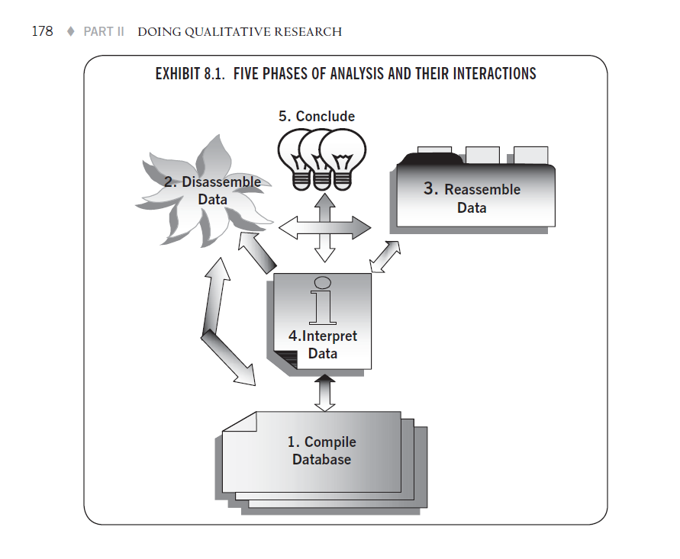
Data analysis
Yin’s five phases:
  Compiling
  Disassembling
  Reassembling
  Interpreting
  Concluding
Analysis is non-linear, recursive
Notes:
As regards this framework, the data collected will be first compiled and sorted. To do this I will read the notes made on the data collected and the interview transcripts over and over again to get familiarized with the data,
Then, the data will be sorted into broad categories.
In the second phase; the disassembling phase, the data will be sorted into smaller fragments or codes.
This step maybe repeated several times on a trial and error basis to test codes.
Based on the results of the second phase the disassembled data fragments will then be sorted to substantive themes or codes
In the fourth phase or the interpreting phase critical discourse analysis methods will be used to interpret the data followed by drawing conclusions based on the interpretations.

Slide 13
Critical discourse analysis
Social conditions of production
Process of production
Description
TEXT
Interpretation
Process of interpretation
INTERACTION
Explanation
Social conditions of interpretation
Discourse as text, interaction and context
(after Fairclough, 1989; Thompson, 2005)
CONTEXT
Notes:
CDA unmasks the power relations that are embedded (often concealed) in the text of all communicative events,
CDA draws from both critical theory and the post-structural approach.
In policy analysis, CDA can be applied to both interview and document texts to identify the relationship between these texts and the contexts that produced and gave meaning to them.
At the center lies the core aspect of analysis, the TEXT.
The TEXT could be written, verbal or visual.
The focus here is on describing the text and its linguistic structures.
The second box marks the interpretation of the TEXT. Here the analyst focuses on production, consumption and reproduction of the text.
The third box looks at the larger social context of the text in focus. It looks at the factors in society that led to the production of texts.

Slide 14
Time line
 | 2013 |  |  |  |  |  | 2014 |  |  |  |  |  |  |  |  |  |  |  |  | 2015 |  |  |  |  |  |  |  |  |  |  |  | 2016
 | Jul-Sep |  |  | Oct-Dec |  |  | Jan-Mar |  |  | Apr-Jun |  |  | Jul-Sep |  |  |  | Oct-Dec |  |  | Jan-Mar |  |  | Apr-Jun |  |  | Jul-Sep |  |  | Oct-Dec |  |  | Jan- Mar |  |  | Apr-Jun
Literature Review
Research Proposal
Development of tools
Data Collection
Data Analysis
Thesis Write-up
Submission of thesis

Slide 15
END
Thank you for your patience

Slide 16
ADDITIONAL DETAILS
slides to answer specific questions that may arise

Slide 17
Critical discourse analysis
Social conditions of production
Process of production
Description
TEXT
Interpretation
Process of interpretation
INTERACTION
Explanation
Social conditions of interpretation
Discourse as text, interaction and context
(after Fairclough, 1989; Thompson, 2005)
CONTEXT
Notes:
“Critical discourse analysis (CDA) is a type of discourse analytical research that primarily studies the way social power abuse, dominance, and inequality are enacted, reproduced, and resisted by text and talk in the social and political context”.
CDA draws from both critical theory and the post-structural approach.
critical analyst searches the dominant discourses for the ideology and power relationships embedded in it.
In policy analysis, CDA can be applied to both interview and document texts to identify the relationship between these texts and the contexts that produced and gave meaning to the texts.
Fairclough’s three-tiered framework for critical discourse analysis: (1) social conditions of production and interpretation, that is, factors in society that led to the production of texts and how these factors affect interpretation; (2) the process of production and interpretation, that is, how texts have been produced and this affects interpretation; (3) the product of the first two stages, the text.
Corresponding to the three levels of discourse, the three stages of CDA prescribed by Fairclough are: (1) description stage concerned with the description of the text and its linguistic structures (text analysis), (2) interpretation stage focused on how the text has been produced, its relationship with similar texts and how the subjects interact with the text (analysis of linkage), and (3) explanation stage focused on the various sociocultural practices and discursive conditions that provide a wider contextual relevance to the text (social analysis)

Slide 18
Original contribution to scholarship
There are four* types of scholarship:
  the scholarship of teaching,
  the scholarship of discovery,
  the scholarship of integration, and
  the scholarship of application.
*Glassick, Huber and Maeroff (1997)
Notes:
Here you could talk about your contribution in each area. The details are the proposal.

Slide 19
Influences
  influences frame the whole policy process
Shaded box
Macro
Macro Text
  influences can feed into the policy text production from any direction
horizontal arrows
  the interconnections between different levels of text production
arrows going up and down
Intermediate
Intermediate Text
  the relative strength of the influence
the size of the arrows
  when the polity elite are more influential in controlling the policy process (macro-level constraint)
Micro
Micro Text
Larger bold arrows coming down and small arrows going up
Practice
(Effects)
  The power exerted by the ‘grassroots’ level practitioners in interpreting the policies (micro-agency).
micro
oblique arrow connecting micro influences and micro effects
A modified policy cycle. Source: Vidovich (2007, p.298)
Notes:
Modifications to Ball’s (1994) policy trajectory have developed over time. For example, Vidovich (2007) has extended the policy trajectory model by superimposing multi- levels from global to local to the contexts proposed by Ball (1994), taking into account the “macro-level constraint and micro-level agency”
Vidovich’s model addresses state-centred constraints, at the same time, emphasizing the important role of empirical studies at the micro-level to also understand agency of policy actors throughout the entire policy process.
Vidovich (2007) highlighted the inter-linkages between different levels and contexts of the policy process as a modification to Ball’s (1994) policy cycle approach.
The model spans the macro-, meso- and micro-levels of the policy trajectory.
The macro-level influences are considered as the global and international influences on the policy process.
Localised contexts, cultural and historical backgrounds, geographical contexts and socioeconomic status are possible micro-level influences.
Figure depicts that a complex array of interactions of influences and text production are occurring at different levels simultaneously giving rise to multiple practices/effects.
Some of these effects can become influence factors again at the three different levels of the policy trajectory.

Slide 20
Research framework
1. Interaction of the processes and contexts that influence agenda setting
2. Exposure of the ideologies and values underlying policy issues and their proposed solutions
3. Effects of the policy and how policies are experienced by the people affected by them.
Policy trajectory approach
Critical theory paradigm
Post-structuralism
1. Critiques of structuralism
2. Rejection of the self-sufficiency of the structures that structuralism posits
3. Interrogation of the binary oppositions that constitute those structures.
Notes:
The conceptual framework to be used in this study is the ‘policy trajectory’ approach that is derived from the critical theory paradigm and Post-structuralism .
Most of u know a trajectory as the path taken by a heavenly body on it’s orbit. In policy terms it is defined as the process through which the policy process takes place. This incorporates the different contexts as well as the levels.
Both critical theory and post-structuralism are concerned with power but they conceive of it in different ways:
Critical theory – focuses on the big picture, the macro – some groups in society have more power than others e.g. the policy elite in government who set policy agendas. In education, this theory is concerned to see if policies can help the disadvantaged students.
Poststructuralism – the focus is on the micro or ‘little picture’–
power circulates at the micro level and can play out differently in different contexts. In education, this theory highlights that policies will play out in various ways depending on the place and time.
The key advantage of using both theories is that your policy analysis can span macro to micro levels of the policy trajectory (ie from global policy trends, through national policies, to policy practices within educational institutions).

Slide 21
Participants
Former & present ministers
School heads
Teachers
Parents
Students
Local authority representatives
Relevant ‘outsiders’ with links to the education system
Notes:
Anybody who has been a part of the policy process and is still alive is a possible participant of this study.
It is the researcher’s aim to conduct semi-structured in-depth interviews with various policy actors in, and connected with, the Maldivian education system during the latter part of the time period 1900 – 2015.
This could include former and present ministers, deputy ministers, school heads, teachers, parents, students, as well as local authority representatives and relevant ‘outsiders’ with links to the education system as a whole.
Interviews with these participants will provide data parallel to the document analysis for recent decades, but for the period earlier in the 20th century, documents will provide the sole source of data.

Slide 22
Limitations & Delimitations
Documents on educational policy for the first five decades may not be available.
Actors from the first and second decades of the 20th century are dead.
Focus on key policies. Not all.
Notes:
Documents on educational policy may not be readily available
I intend to identify policies of that period on documents extant as well as by interviewing those policy actors still living.
For completeness and for a fuller appreciation of the policy, the study includes the period from 1900 to 2015

Slide 23
Ethical Considerations
Fully complies with MNU ethics guidelines
Participants will be kept comfortable and free from harm.
Consent to participate will be sought in writing before interviewing.
After the data is collected and transcribed, the data will be shared with the participants to check for accuracy
The identity of the participants will be kept confidential at all times.
Digital recordings of the interviews will be kept safely locked or password protected
The right to withdraw from the study at any point of time will be available to the participant throughout the study

